Slide 1

Body Image Coach
Prevention & Personal Growth
Welcome

Slide 2
Body Image Coach
Prevention & Personal Growth
Our service
Tier 1 early prevention psychoeducational service
Support young people experiencing body image anxieties and early mental health difficulties linked to body dissatisfaction
Not-for-profit Community Interest Company (CIC)
Fully online service delivering support across the UK, predominantly West Yorkshire
Work alongside parents, schools and healthcare professionals for wrap around support
Set up service in July 2023 and have supported over 360 young people to date
We set up due to lived experiences of eating disorders and body dysmorphic disorder

Slide 3
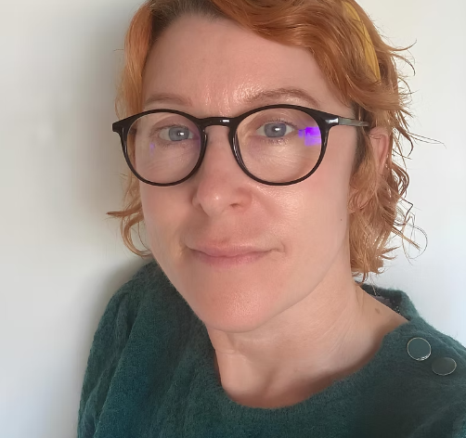
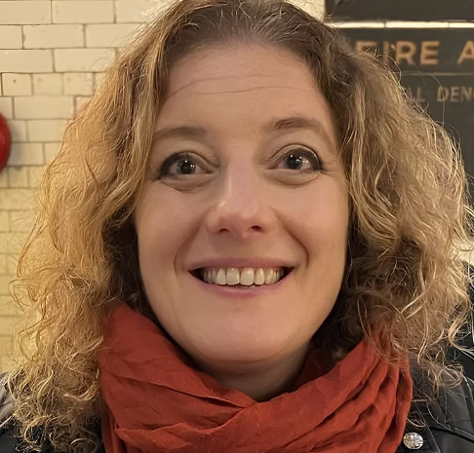
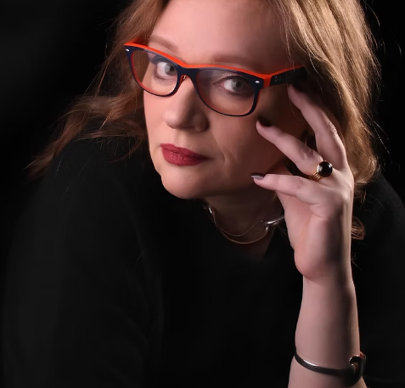
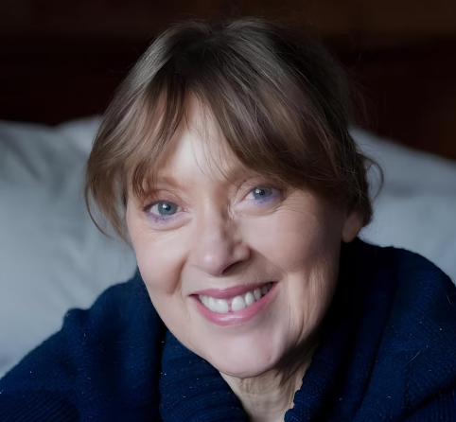

Body Image Coach
Who We Are
Prevention & Personal Growth
Olivia – Director, Coach and Trainer, Safeguard Lead (with International Coaching Federation)
Jane – Director, student, administration
Antoinette – Director, GDPR
Jennie– Psychotherapist with NCPS (Private Practice) content collaborator
Adam – Psychotherapist with NCS (Private Practice) content collaborator
Over 40 years combined professional and lived experience in body image disorders, neurodiversity and mental health

Slide 4
Body Image Coach
Prevention & Personal Growth
Who We Support
Young people (11–25) in two groups – 11-16’s and 16 – 25’s
Parents and carers
Schools and colleges
Community organisations
Professionals working with young people

Slide 5
Body Image Coach
Prevention & Personal Growth
Our Vision
We empower young people to build a healthy relationship with their bodies, strengthen self-worth and develop emotional resilience through early prevention and education.
Our Mission
Ensuring that no person suffers alone.

Slide 6
Body Image Coach
Prevention & Personal Growth
Why This Matters
Most people in this room will know a family member, friend, or someone in their wider network who has a child struggling with an eating disorder, body dysmorphic concerns, or similar challenges
1 in 3 young people aged 11–25 say worries about their body image stop them doing everyday activities.
Around 1 in 50 people in the UK are estimated to experience body‑dysmorphic‑related concerns (BDD Foundation).
Eating disorders affect an estimated 1.25 million people in the UK, with most cases beginning in adolescence or early adulthood.
Social media pressure is reported by over 70% of young people as a major influence on how they feel about their bodies.

Slide 7
Body Image Coach
Prevention & Personal Growth
Our Approach
A 6-week psychoeducational program in animation
Interactive learning with X2 comprehensive workbooks during and after program delivery
Parent/carer/provider guidance
Online community hub for over 18’s with a library of resources after program completion
1-1 participant support where needed
Check ins during program delivery to ensure learning is retained and practiced
Signposting where needed

Slide 8
Body Image Coach
Prevention & Personal Growth
Our Approach
Screening each participant to manage risk
Speaking with providers, parents/carers and CAMHS/NHS where needed
Ensuring that high risk participants are being monitored by clinical services
Carrying out inductions, safeguarding set up and contracts with a safety plan should a person
present high risk or crisis during the program delivery

Slide 9
Body Image Coach
Prevention & Personal Growth
What Makes Us Different
Prevention-focused tier 1 service
Self referrals
Lived and professional experience
Flexible delivery with on demand workshops in animation
Whole-family approach with a community hub to support parents and providers
Focused specifically and solely on body image

Slide 10
Body Image Coach
Prevention & Personal Growth
How We Measure Success
Participant feedback before and after
Parents/carer and participant inductions before and after program to gain insight
Weekly check-ins on progress
Testimonials on Trust Pilot

Slide 11
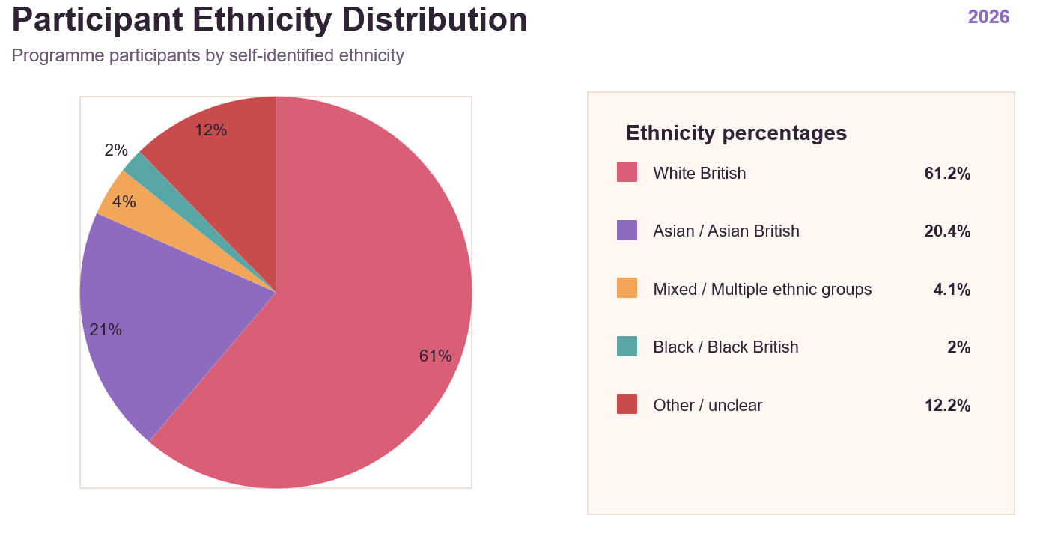
Body Image Coach
Stats for 2026
Prevention & Personal Growth

Slide 12
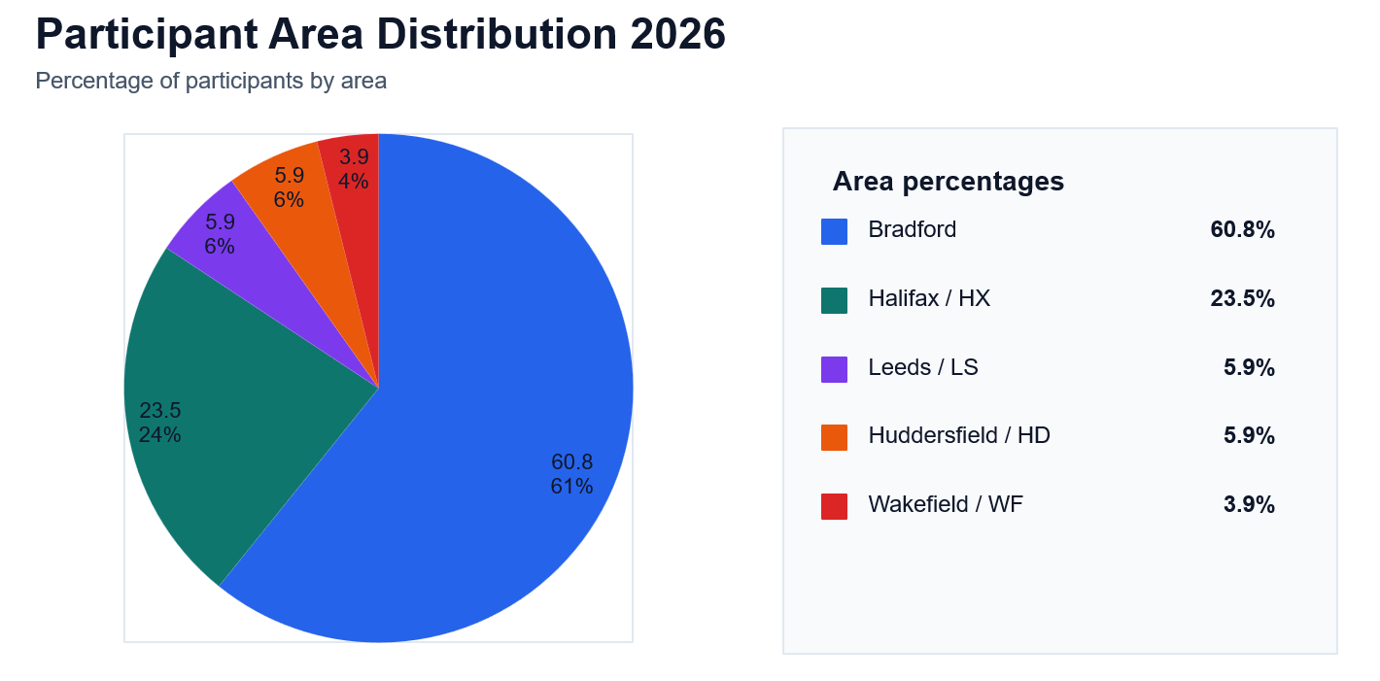
Body Image Coach
Stats for 2026
Prevention & Personal Growth

Slide 13
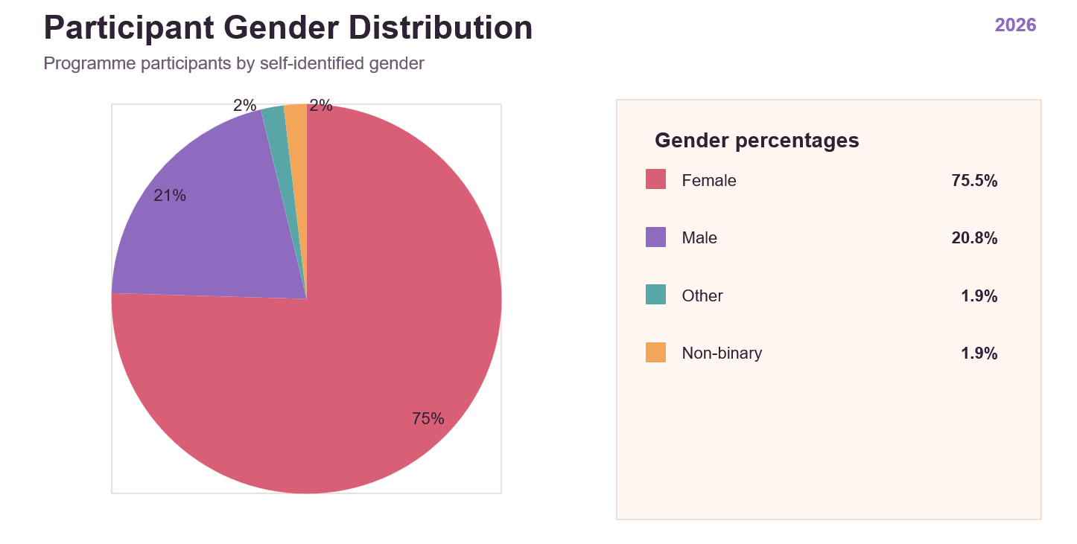
Body Image Coach
Stats for 2026
Prevention & Personal Growth

Slide 14
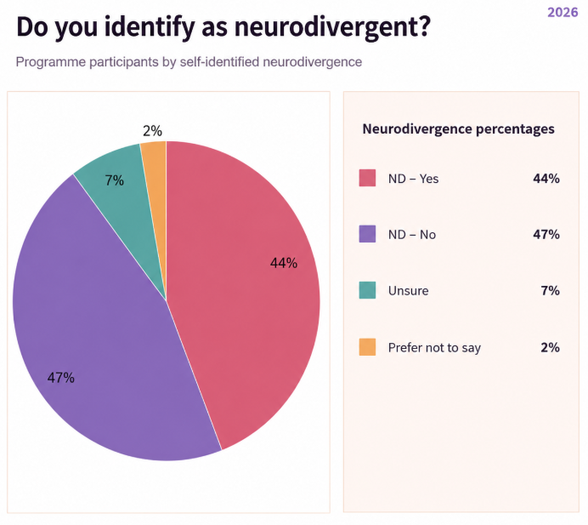
Body Image Coach
Stats for 2026
Prevention & Personal Growth

Slide 15
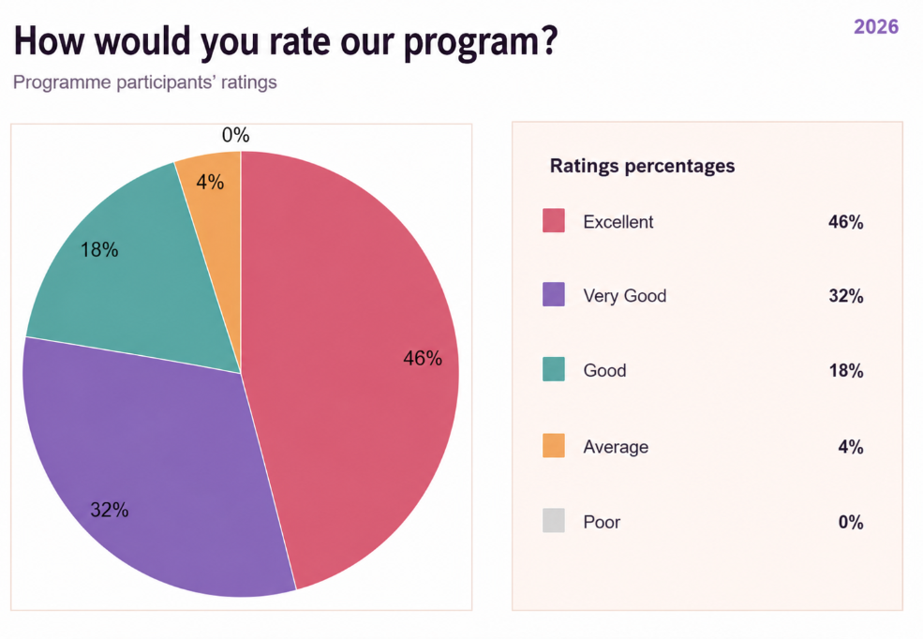
Body Image Coach
Stats for 2026
Prevention & Personal Growth

Slide 16
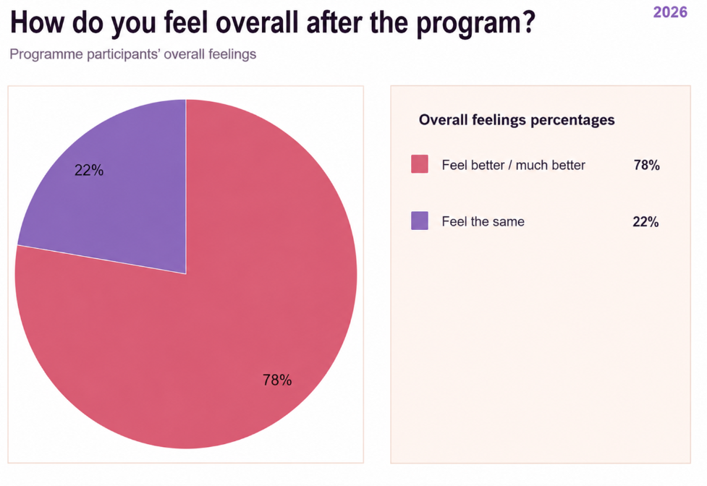
Body Image Coach
Stats for 2026
Prevention & Personal Growth

Slide 17
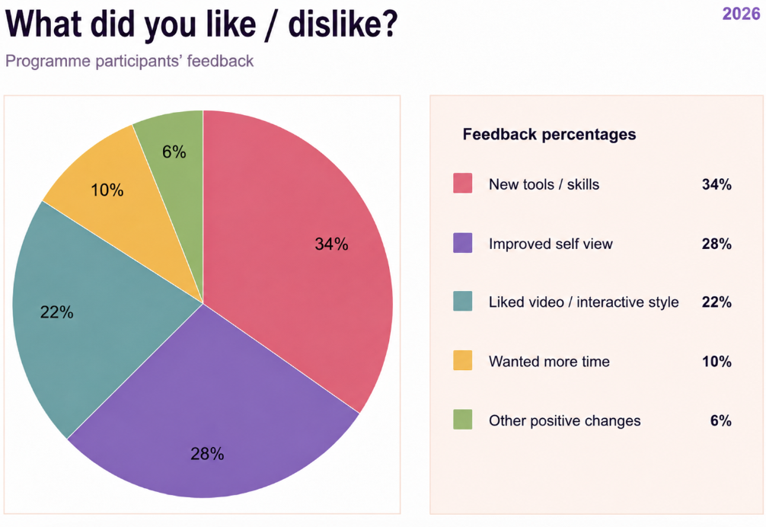
Body Image Coach
Stats for 2026
Prevention & Personal Growth

Slide 18
Body Image Coach
Prevention & Personal Growth
Thank you

